Slide 1
Narrative Conventions

Slide 2
VOCABULARY
Find the definition of 2 words from chapter 2
Give one, get one for your third definition from a peer

Slide 3
Poster Time!

Slide 4
YOUR TASK
IN GROUPS OF 2-3 CREATE A POSTER ON ONE OF THE FOLLOWING NARRATIVE CONVENTIONS
Don’t forget to include:
- a definition
- a few examples
- symbolic images
MAKE IT PRESENTABLE!

Slide 5
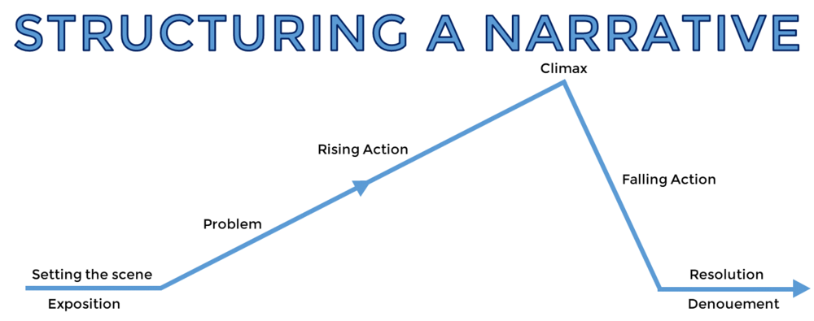

PLOT – WHAT?

Slide 6
Setting – WHERE?
- Time
- Date
- Place
- Environment
- Imagery

Slide 7
Characterisation – WHO? (SAAO)
Speech – dialogue between characters
Appearance – what do they wear, look like
Actions – what do they do
Other – what do other characters say or feel about the character/s you are focusing on

Slide 8
Point of View – WHO?
The point of view that a text is written in provides an idea of the author’s purpose.
1st person – Uses I and me. The aim is to personalise and build a connection with the reader so we are more empathetic.
2nd person – Uses you. Direct address (more commonly used in persuasive writing) can also form a connection with the reader. E.G. A character speaking to the reader as though we are their sub-conscious.
3rd person – Uses pronouns and names, and is very commonly used in descriptive writing. The reader is positioned to ‘watch’ the scene as though we are on the outside looking in.

Slide 9
THEME – WHY?
What is the author trying to get across to the audience?

Slide 10
CONFLICT – THE PROBLEM
External:
Character Vs. Environment
Character vs. Society
Character Vs. Supernatural
Character Vs. Character
INTERNAL:
Character Vs. Self

